Slide 1
How Your Student Would Design Your Online Course
Amy Pilcher
Iowa State University

Slide 2
What do Students want most?
Immediate Feedback
Timely responses
Personalized responses
Personal connection
Multimedia
Interaction
Regular chances for communication
To see your passion for the subject come through

Slide 3
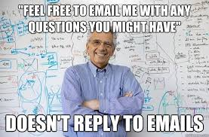
#1 Student Complaint
Absent Instructor

Slide 4
Organize
Go through your content and course before the semester begins
Make sure all links work
Check syllabus and other information for correct dates, contact, etc.
Organize your course by modules
Give your files names that make sense to your students or others who have never seen the content before

Slide 5
Non Examples
Pages 6-8 are non examples of sufficient organization.

Slide 6
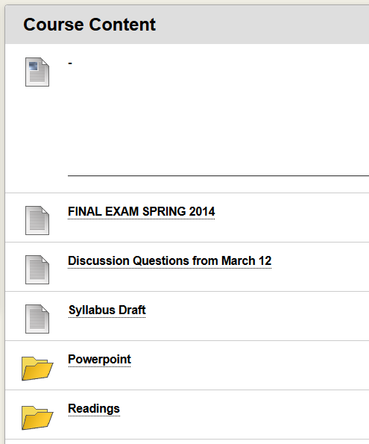

Slide 7
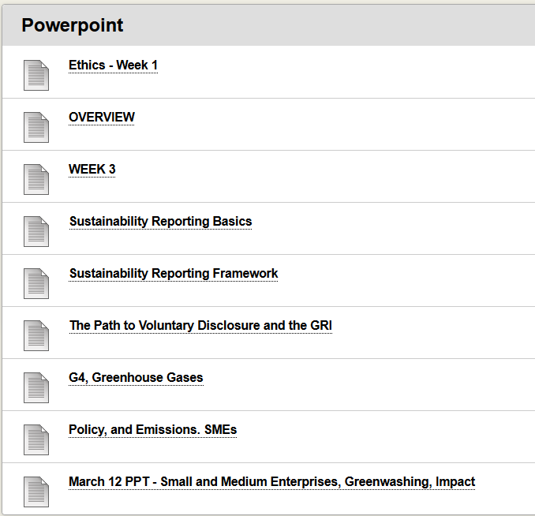

Slide 8
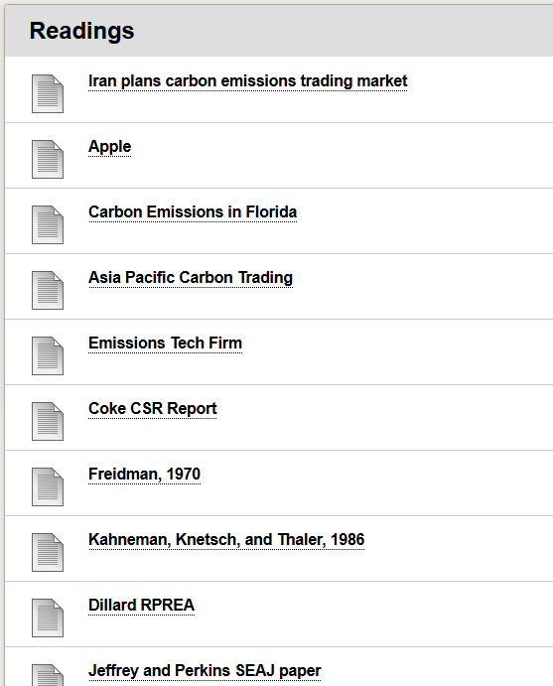

Slide 9
Simplify
Break your syllabus into sections
Break your course and videos into short sections
Use technology
Create “canned” feedback that can be customized
Provide students with the resources they need to succeed
Use features in your LMS for organization if available
Notes:
Don’t try too much at once. Practice with technology before using it in your course. Don’t overwhelm yourself or your course with technology

Slide 10
Tell Students who they should contact
LMS Support
Technical support
Technology supplement support
Help desk
Library assistance
Academic or program information
Registration (withdrawal, etc.)
Financial aid

Slide 11
Communicate
Over explain
Give thorough directions to decrease questions
Never assume students understand your directions
Provide meaningful and timely responses
Engage students
Feedback

Slide 12
Clear Guidelines and Expectations
How to get started
What needs done
When it needs done by
How it should be completed
How/where to ask questions
When/how you will interact
Process for grading and feedback

Slide 13
Communicate
How often will you log-in and interact?
How quickly will you respond to student inquiries?
How do you want students to communicate with you? With each other?
How often should students log on and interact?
How many hours per week should students plan to spend in your course?
How long should an assignment take?
Invite students to interact with you
Communicate regularly with your class

Slide 14
Example of Non-Detailed Communication
Example
Assignment: Submit a curriculum plan for a course
There is value in adding rubrics and example assignments. Students can’t give you what you want if you don’t ask them for it

Slide 15
Provide Examples and Demonstrations
Videos | Sample Documents
Weekly Introduction and Summary | Assignment samples (good, average, and poor)
Warnings about “trouble spots” | Grading Rubrics
Syllabus overview | Assignment Formatting
Course overview
Notes:
Include other resources available such as library, available campus technology and support

Slide 16
Engage
Ask for their experiences
Ask them to share what things in their work or life contribute to the course
Have students self-disclose
Upload Bio and Photo
Share hopes/expectations
Share yourself and your experiences

Slide 17
Student to Content Engagement
Don’t let your LMS and website get in the way of learning
Ask them to share current news that relates to the topic in discussion boards
Ask them to share what things in their work or life contribute to the course
Have them take field trips and write reflections on their experience
Apply course theories and content in unique ways
Ask your students to make an infographic of a reading assignment

Slide 18
There’s an app for that
Students are more likely to engage with content they can access on their mobile device
Avoid or reduce the amount of downloadable items in your courses
Make sure your videos are accessible to be watched anytime/anywhere
Students can engage with your material on the bus on the way to work

Slide 19
Peer-to-Peer Interaction
Use social networks and discussion boards
Take advantage of what students know and can share with each other
Utilize peer teaching and peer learning.
Use group projects and encourage collaboration
Provide a “Student Lounge”

Slide 20
Social Media as a Classroom Tool
Connect with students where they are
Offer online office hours through social media channels
Facilitate group work and class interaction on social media
Increase student communication without increasing your email
Increase student engagement

Slide 21
Free Technology
Remind 101
www.remind.com
Teachers sign up, create a class, add students
Sends text message reminder to students
Screencast-O-Matic
www.screencast-o-matic.com
Screen capture recording on any system
Online tool – does not require installation of any software for use
TitanPad
www.titanpad.com
Similar to Google Docs for sharable editing
Allows you to track changes

Slide 22
Technology cont.
Twitter
Facebook
Google+
Google Hangouts
Google Docs – Kaizenz is a free audio feedback tool that works with Google Docs
Podcast

Slide 23
Free Technology (Cont.)
Canned Feedback tools
Typinator
Breevy
Dash
Text Expander
Microsoft Quick Parts
Zoom Video Conferencing
YouTube

Slide 24
Resources
Anderson, T., Rourke, L., Garrison, D., & Archer, W. (2001). Assessing teaching presence in a computer conferencing context. Journal of Asyncronous Learning Networks, 5(2), 1-17.
Arbaugh, J. (2008). Does the community of inquiry framework predict outcomes in online MBA courses? International Review of Research in Open and Distance Learning, 9(2), 1-21.
Bailey, C. J., & Card, K. A. (2009). Effective pedagogical practices for online teaching: Perception of experienced instructors. Internet and Higher Education, 12, 152-155.
Baumeister, R., & Leary, M. (1995). The need to belong: Desire for interpersonal attachment as a fundamental human motivation. Psychological Bulletin, 117, 497-529.
Bayne, S. (2004). Mere jelly: the bodies of networked learners. Sheffield Networked Learning Conference.
Benke, M., & Miller, G. (2014). Optimizing Student Support Success through Student Support Services. In G. Miller, M. Benke, B. Chaloux, L. Ragan, R. Schroeder, W. Smutz, et al., Leading the e-Learning Transformation of Higher Education (pp. 132-148). Sterling, VA: Stylus.
Boling, E., Hough, M., Krinsky, H., Saleem, H., & Stevens, M. (2012). Cutting the distance in distance education: Perspectives on what promotes positive, online learning experiences. Internet and Higher Education, 15, 118-126.
Bowen, W. G. (2013). Higher Education in the Digital Age. Princeton: Princeton University Press.
Carini, R. M., Kuh, G. D., & Klein, S. P. (2005). Student Engagement and Student Learning: Testing the Linkages. Research in Higher Education, 47(1), 1-32.
Chickering, A. W., & Gamson, Z. F. (1987). Seven Principles for Good Practice in Undergraduate Education. Washinton Center News, 75-81.
Christensen, C. M., Horn, M. B., & Johnson, C. W. (2011). Disrupting Class. New York: McGraw Hill.
Correia, A., & Davis, N. (2008). Intersecting communities of practice in distance education. Distance Education, 29(3), 289-306.
Dawson, S. (2006). A study of the relationship between student communication interaction and sense of community. Internet and Higher Education, 9, 153-162.
Delahunty, J., Verenikina, I., & Jones, P. (2013). Socio-emotional connections: identity, belonging and learning in online interactions. Technology, Pedagogy and Education, 23, 243-265.
Gallacher-Lepak, S., Reilly, J., & Killion, C. M. (2009). Nursing student perceptions of community in online learning. Contemporary Nurse, 32(1-2), 133-146.
Garrison, D. (2004). Online Community of Inquiry Review: Social, Cognitive, and Teaching Presence Issues. Retrieved April 20, 2015, from SUNY Learning Network: http://www.google.com/url?sa=t&rct=j&q=&esrc=s&source=web&cd=7&ved=0CFMQFjAG&url=http%3A%2F%2Fwiki.sln.suny.edu%2Fdownload%2Fattachments%2F4032379%2Fv11n1_8garrison.pdf&ei=-0c-VbO4C9K4oQTR8oDoBA&usg=AFQjCNHmFxfmsgti52Bf9WZ-naQq2AlpDQ&sig2=AzO5DrY9Na1PuZ0e
Garrison, D., & T. Anderson, W. A. (2000). Critical inquiry in a text based environment: computer conferencing in higher education. Internet and Higher Education, 11(2), 1-14.
Gunawardena, C., & Zittle, F. (1997). Social presence as a predictor of satisfaction within a computer-mediated conferencing environment. American Journal of Distance Education, 11(3), 8-26.
Hill, J. R., Song, L., & West, R. (2009). Social Learning Theory and Web-Based Learning Environments: A Review of Research and Discussion of Implications. American Journal of Distance Education, 23(2), 88-103.
Holder, B. (2007). An investigation of hope, academics, environment, and motivation as predictors of persistence in higher education online programs. Internet and Higher Education, 10, 245-260.

Slide 25
Resources (Cont.)
Kuh, G. D. (2001). Assessing what really matters to students. Change, 10-17.
Lee, S. J., Srinivasan, S., Trail, T., Lewis, D., & Lopez, S. (2011). Examining the relationship among student perception of support, course satisfaction, and learning outcomes in online learning. Internet and Higher Education, 14, 158-163.
Liu, X., Magjuka, R. J., Bonk, C. J., & Lee, S.-h. (2007). Does Sense of Community Matter? The Quarterly Review of Distance Education, 8 (1), 9-24.
Lorenzo, G., & Moore, J. (2002). Five Pillars of Quality Online Education. Newburyport, MA: Alfred P. Sloan Foundation.
McInnerney, J. M., & Roberts, T. S. (2004). Online Learning: Social Interaction and the Creation of a Sense of Community. Educational Technology & Society, 7(3), 73-81.
Miller, M. D. (2014). Minds Online: Teaching Effectively with Technology. Cambridge: Harvard University Press.
Paechter, M., Maier, B., & Macher, D. (2010). Students' expectations of, and experiences in e-learning: Their relation to learning achievements and course satisfaction. Computers & Education, 54, 222-229.
Pelz, B. (2004). (My) Three Principles of Effective Online Pedagogy. JALN, 8(3), 33-47.
Perotta, C. (2006). Learning to be a psychologist: the construction of identity in an online forum. Journal of Computer Assisted Learning, 22, 456-466.
Renes, S. L., & Strange, A. T. (2011). Using Technology to Enhance Higher Education. Innovations in Higher Education Vol. 36, 203-213.
Rovai, A. P. (2002). Sense of community, perceived cognitive learning, and persistence in asynchronous learning networks. Internet and Higher Education, 5, 319-332.
Rovai, A. P., & Wighting, M. J. (2005). Feelings of alienation and community among higher education students in a virtual classroom. Internet and Higher Education, 8, 97-110.
Rovai, A., Ponton, M. K., & Baker, J. D. (2008). Distance Learning in Higher Education. New York, NY: Teachers College Press.
Rovai, A., Wighting, M., & Liu, J. (2005). School climate: Sense of classroom and school communities in online and on-campus higher education courses. Quarterly Review of Distance Education, 6, 361-374.
Rovai, A., Wighting, M., & Lucking, R. (2004). The classroom and school community inventory. Internet and Higher Education, 7, 263-280.
Ryman, S., Burrell, L., & Richardson, B. (2009). Creating and Sustaining Online Learning Communities: Designing Environments for Transformative Learning. International Journal of Pedagogies and Learning, 5(3), 46-58.
Sadera, W. A., Robertson, J., Song, L., & Midon, M. N. (2009). The Role of Community in Online Learning Success. Journal of Online Learning and Teaching, 5(2), 277-285.
Selingo, J. J. (2013). College (Un) Bound. Boston: New Harvest Houghton Mifflin Harcourt.
Shea, P., & Bidjerano, T. (2009). Community of inquiry as a theoretical framework to foster "epistemic engagement" and "cognitive presence" in online education. Computers & Education, 52, 543-553.
Shea, P., Li, C. S., & Pickett, A. (2006). A study of teaching presence and student sense of learning community in fully online and web-enhanced college courses. Internet and Higher Education, 9, 175-190.
Shea, P., Li, C., Swan, K., & Pickett, A. (2002). Developing learning community in online asynchronous college courses. Journal of Asynchronous Learning, 9(4), 59-82.
Shelton, K., & Saltsman, G. (2005). An Administrators Guide to Online Education. Greenwich: Information Age Publishing.
Shelton, K., & Saltsman, G. (2005). An Administrator's Guide to Online Education. Greenwich, CT: Information Age Publishing.
Simpson, O. (2012). Supporting Students for Success in Online and Distance Education. New York, NY: Routledge.
Stansfield, M., McLellan, E., & Connolly, T. (2004). Enhancing Student Performance in Online Learning and Traditional Face-to-Face Class Delivery. Journal of Information Technology Education,3, 173-189.
Strayhorn, T. L. (2012). College Students' Sense of Belonging: A Key to Educational Success for all Students. New York: Routledge.
Tinto, V. (1997). Classrooms as communities-exploring the educational character of student persistence. Journal of Higher Education, 68 (6), 599-623.
Wise, A., Duffy, T., & Padmanabhan, P. (2008). Deepening online conversation. Educational Technology, 48(4), 3-11.

